Slide 1


WELCOME TO
FCAP PHILIPPINES
FCAP Philippines in Summary

Slide 2
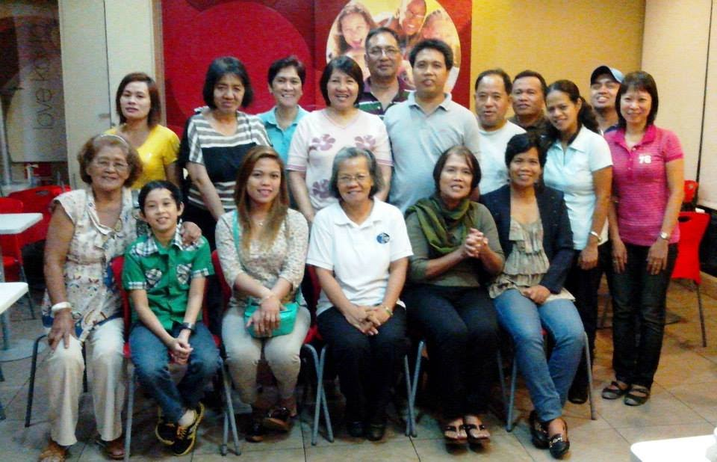

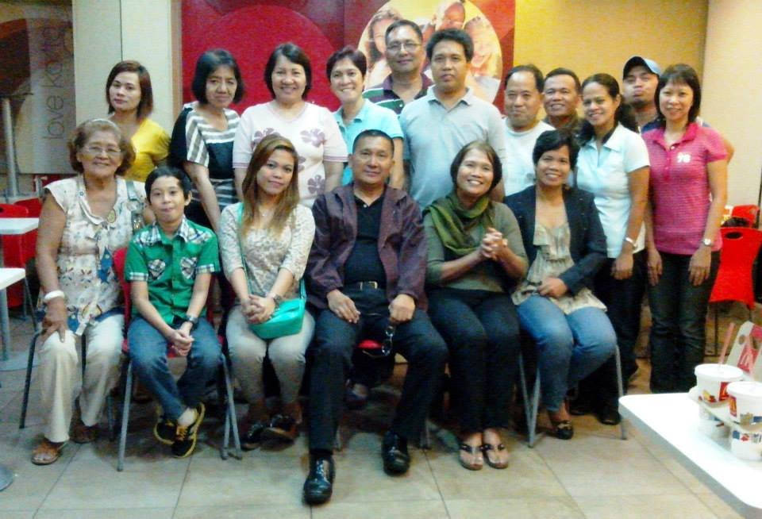
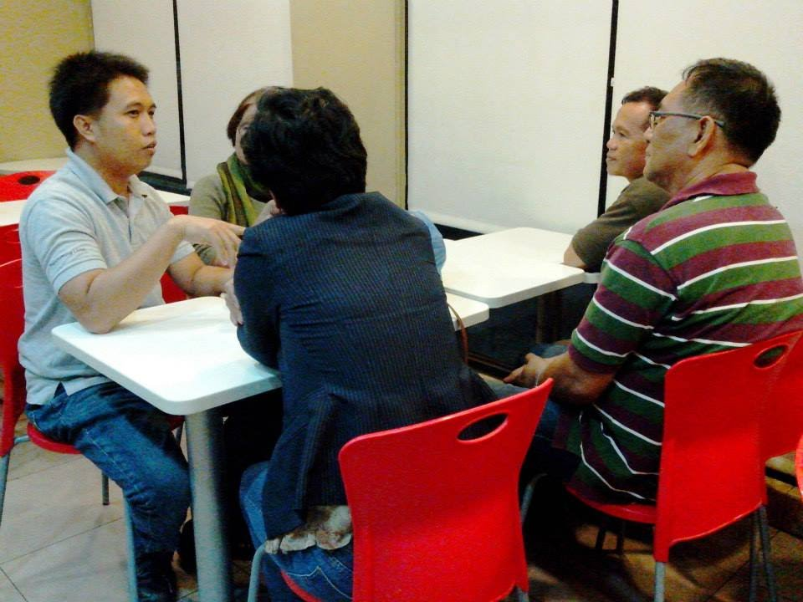
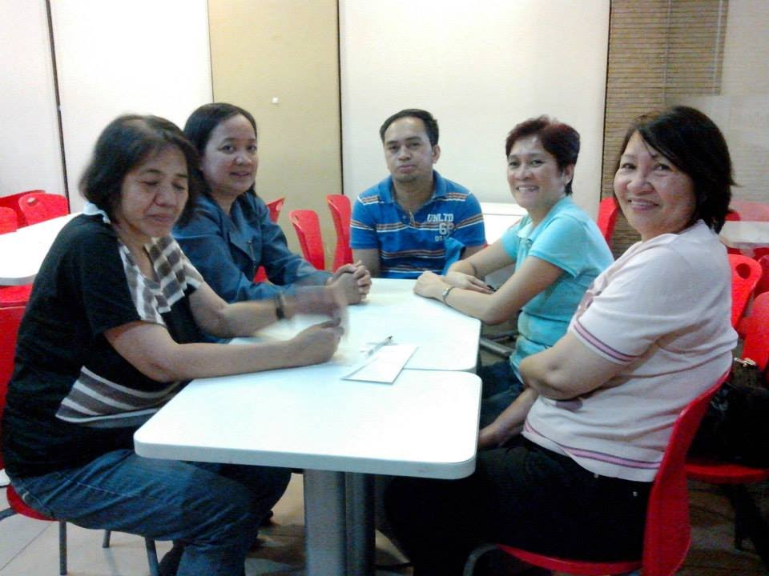
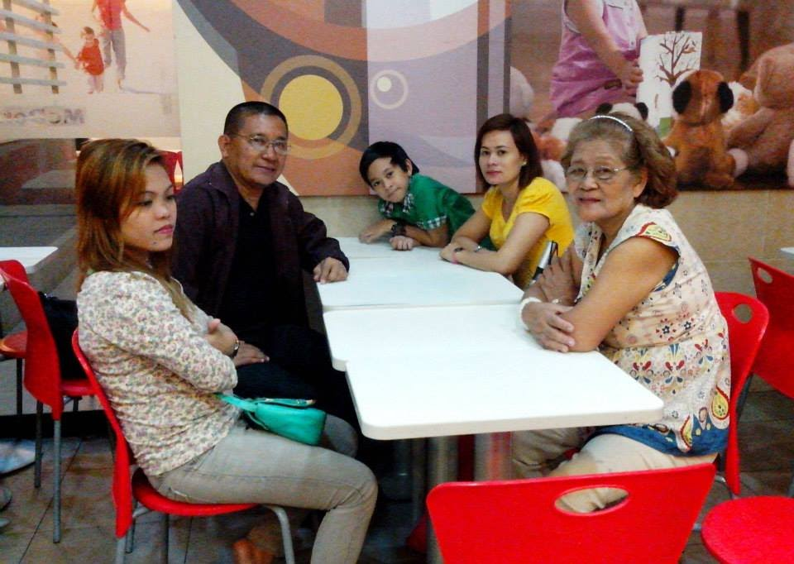
FCAP 12TH ANNIVERSARY THANKSGIVING

Slide 3
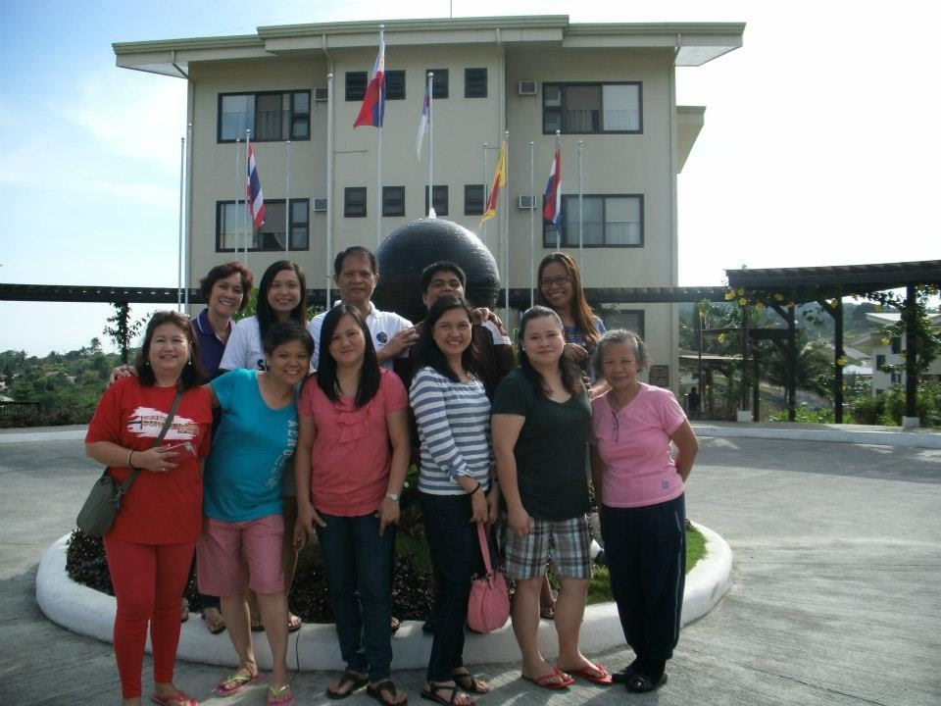
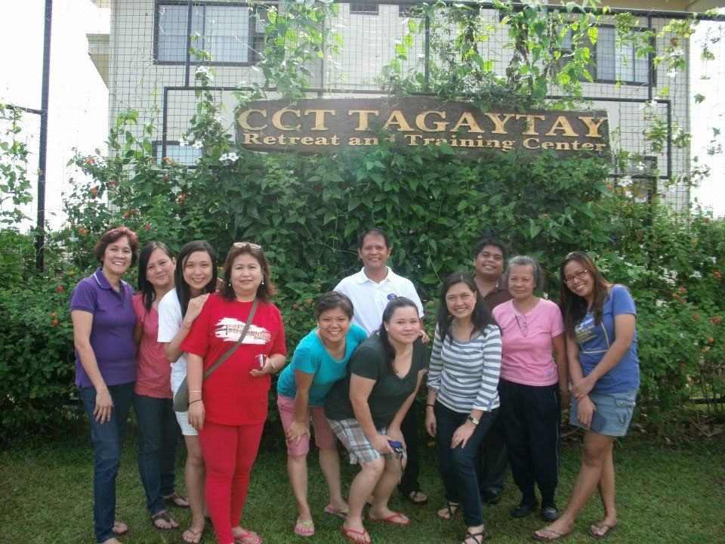
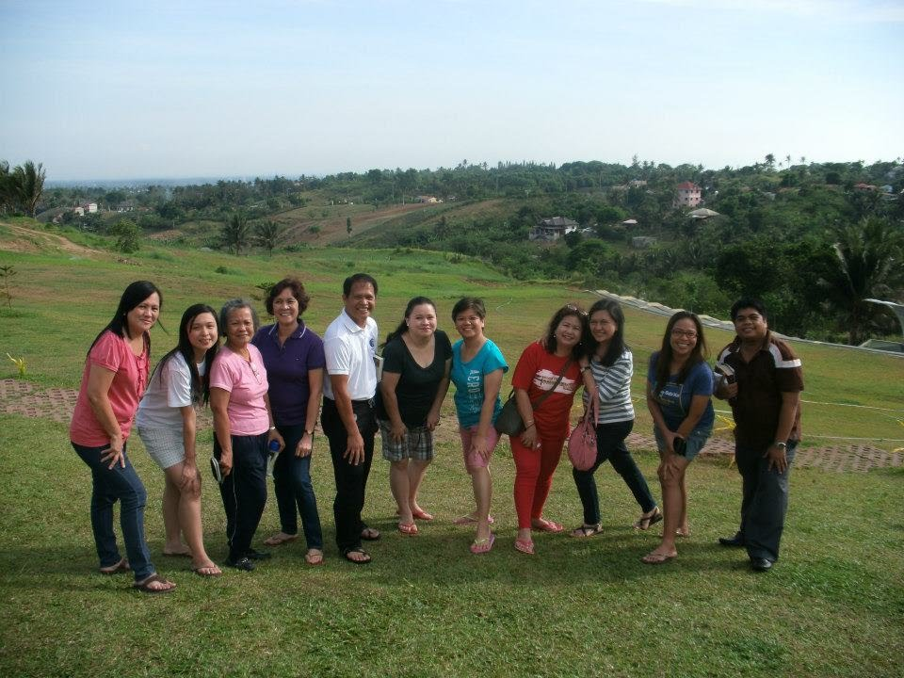
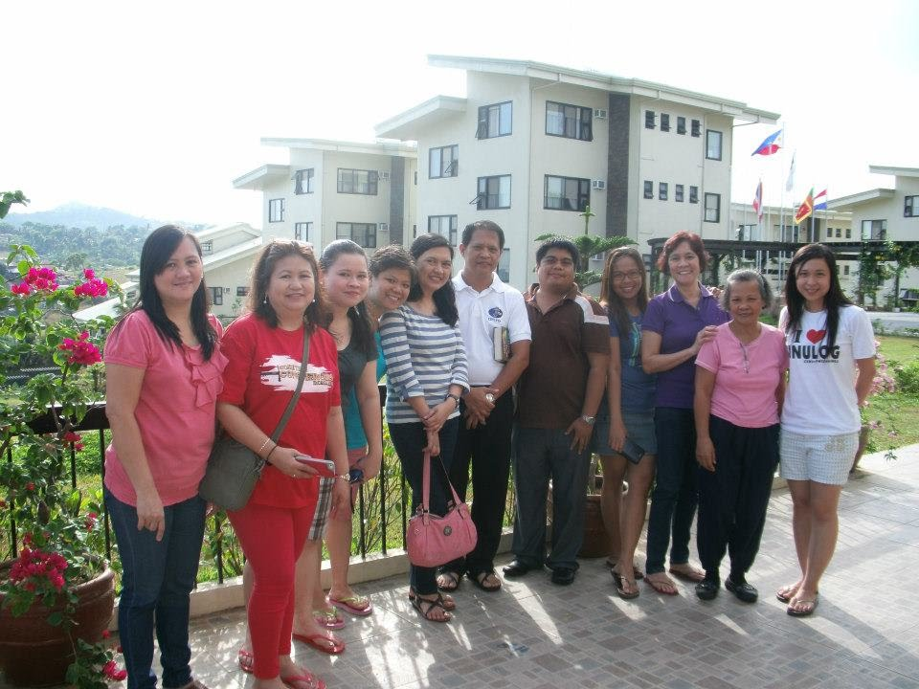
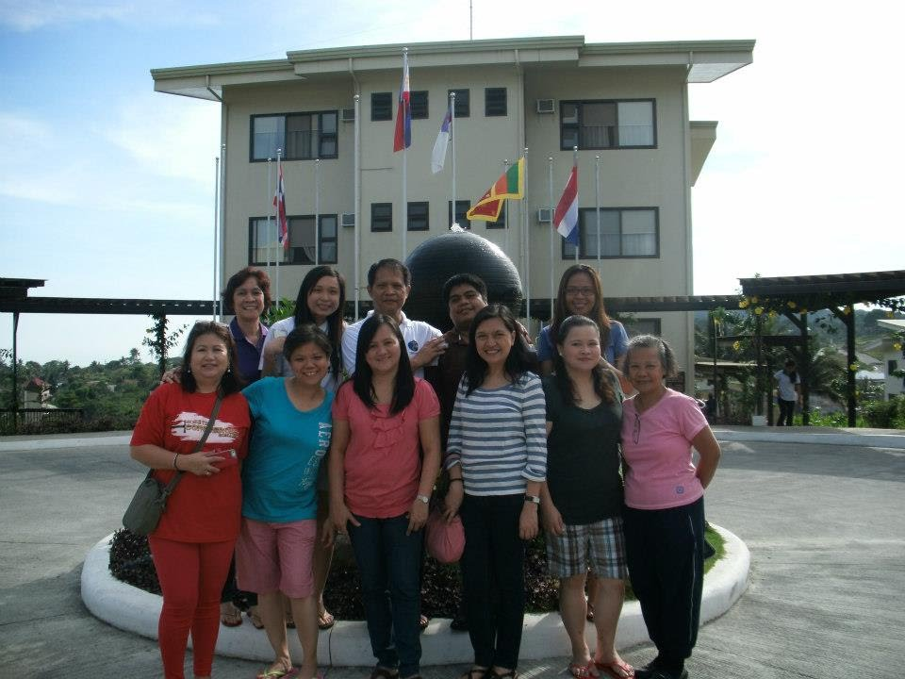
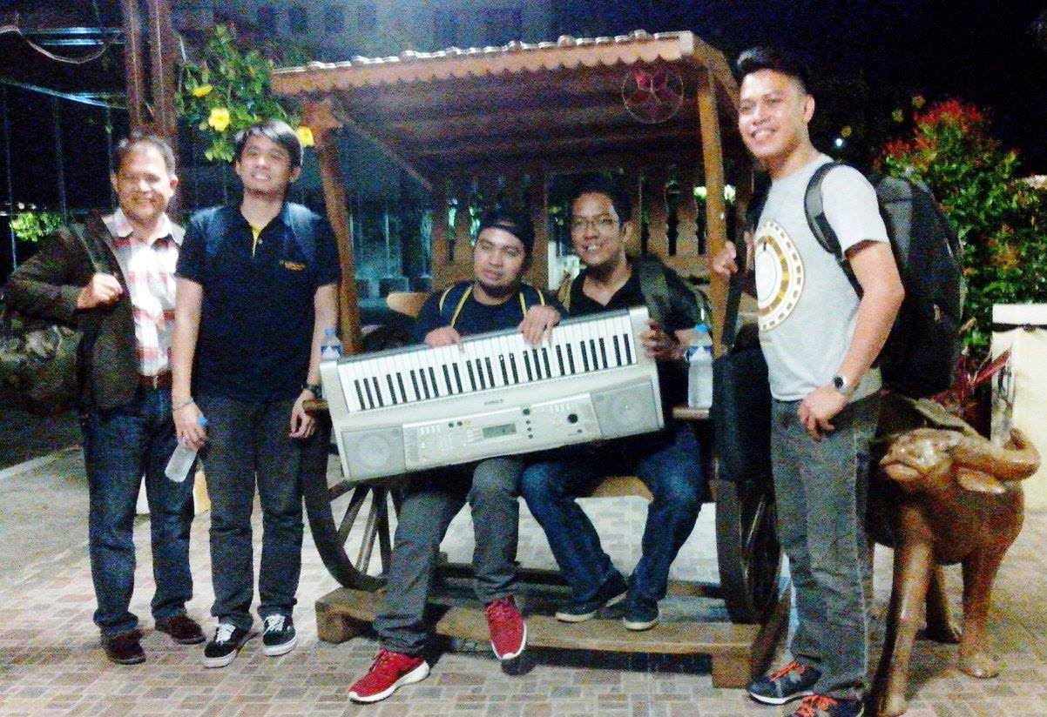
RETREAT @ CCT TAGAYTAY , APRIL 2013

Slide 4
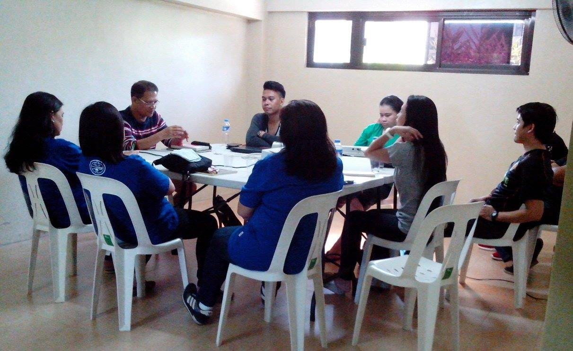
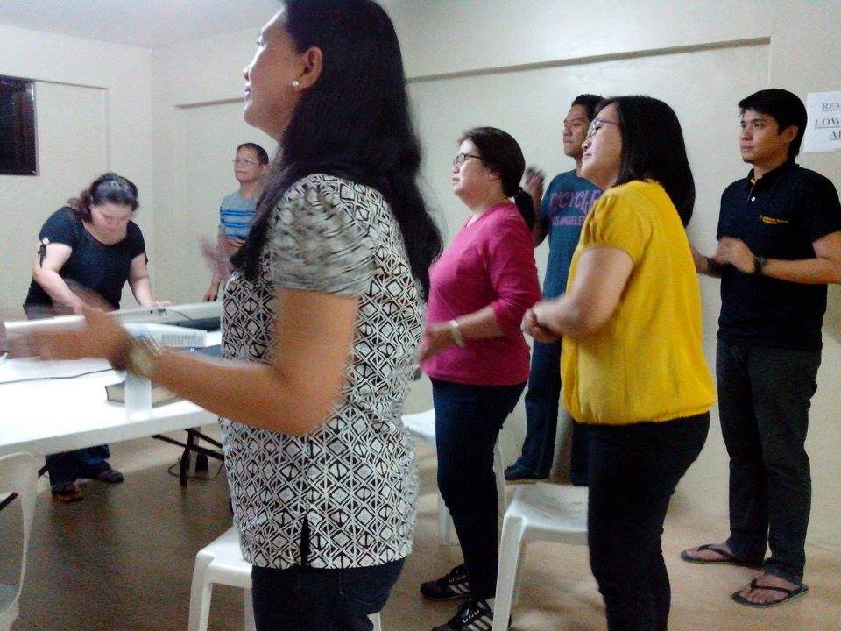
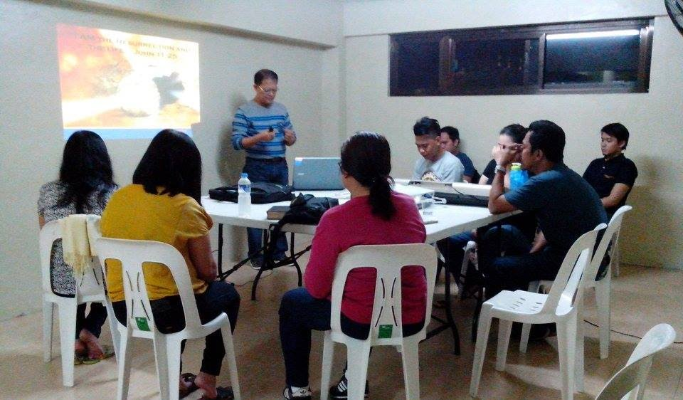
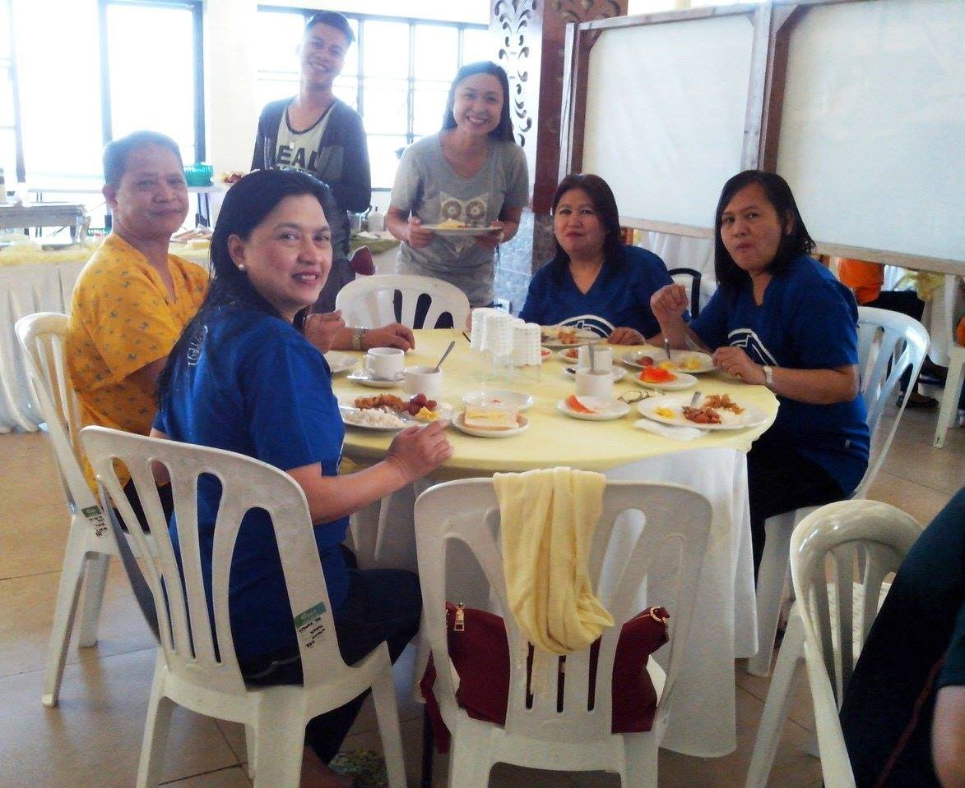
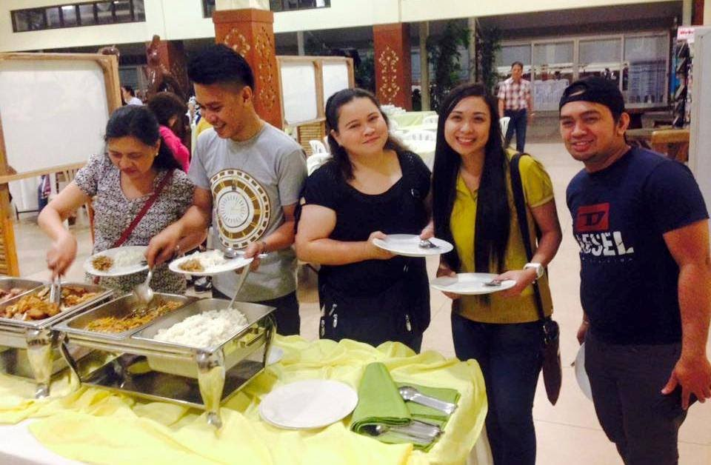
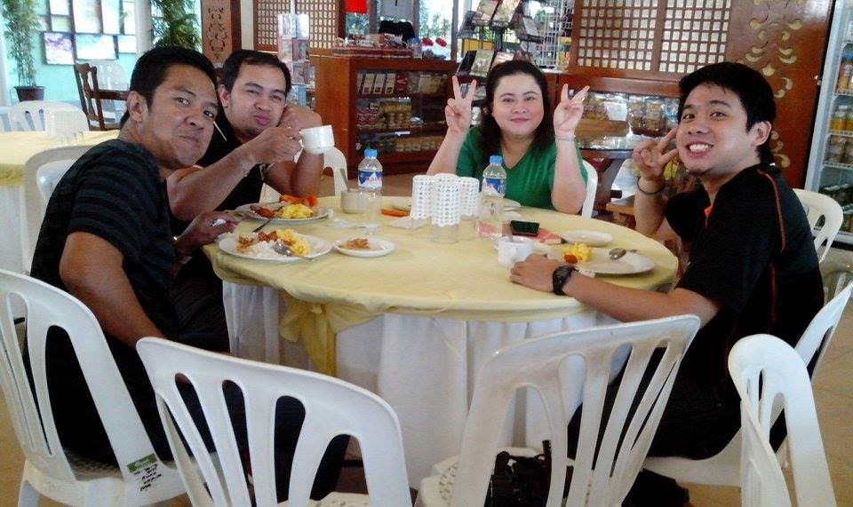
RETREAT @ CCT TAGAYTAY , APRIL 2013

Slide 5
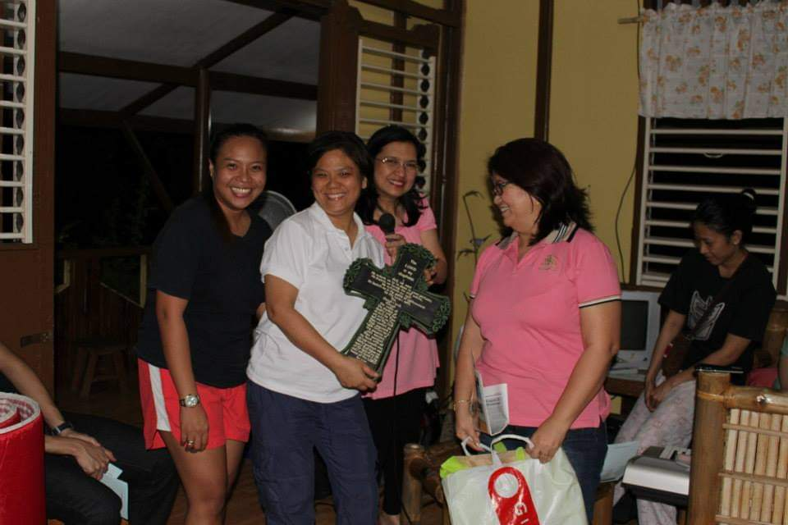
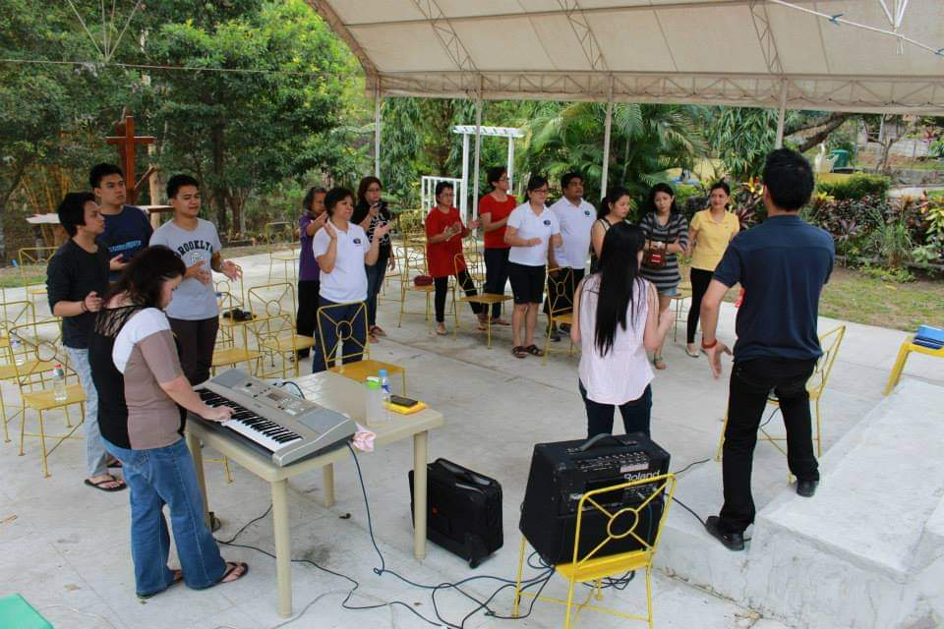
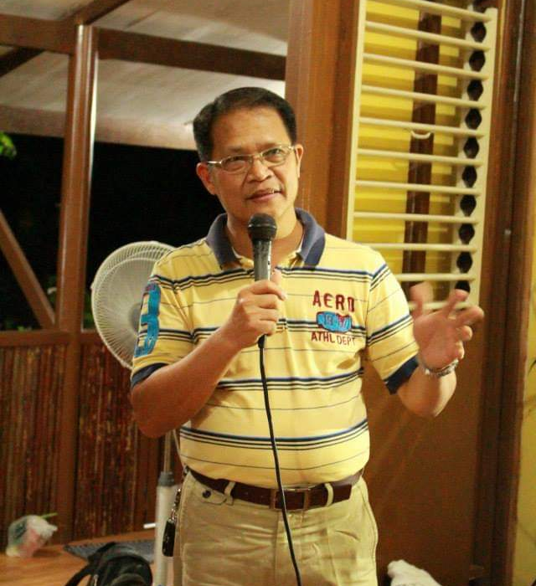
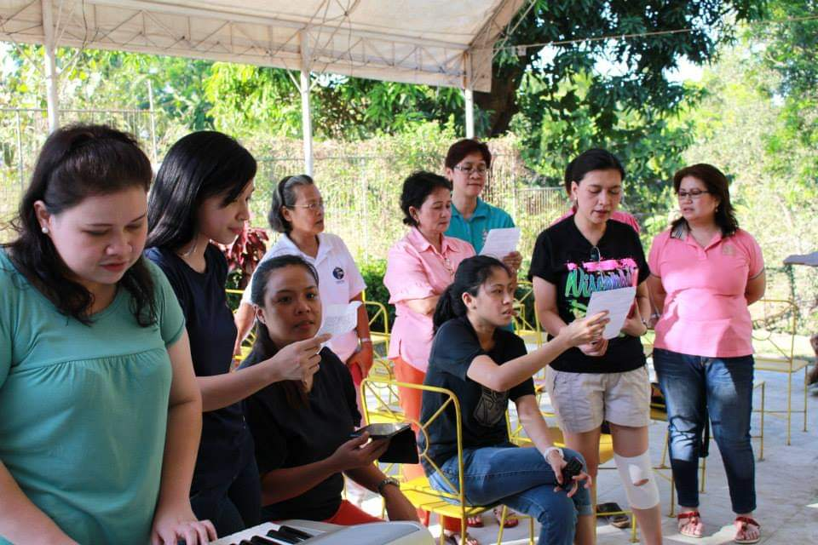
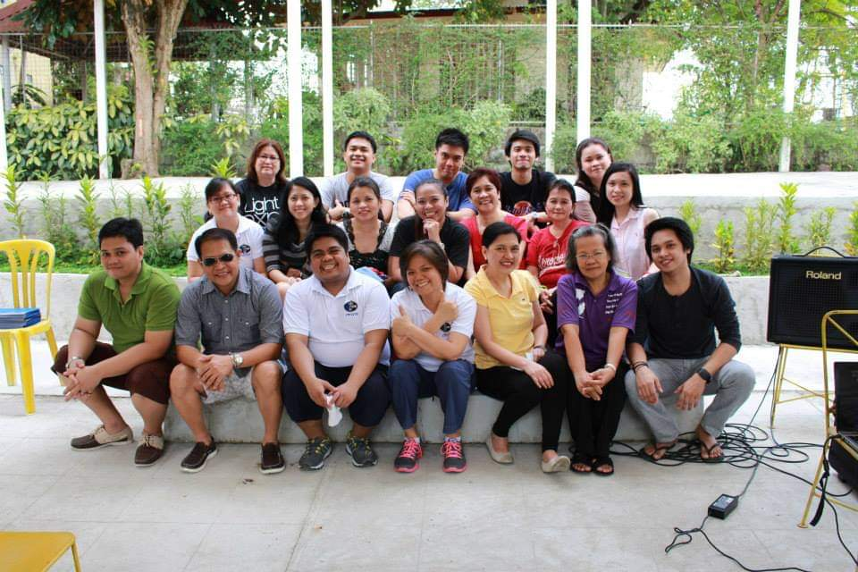
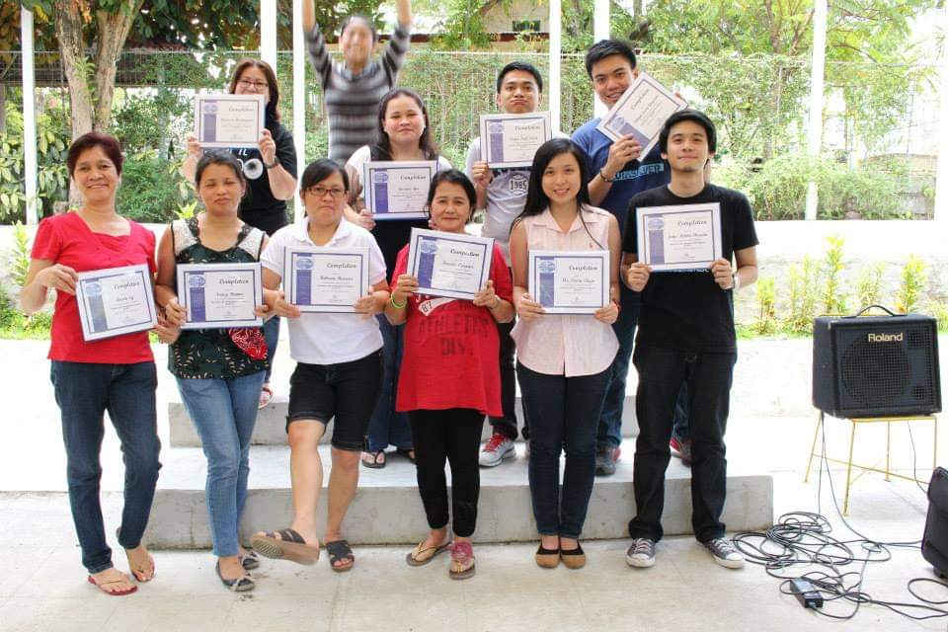
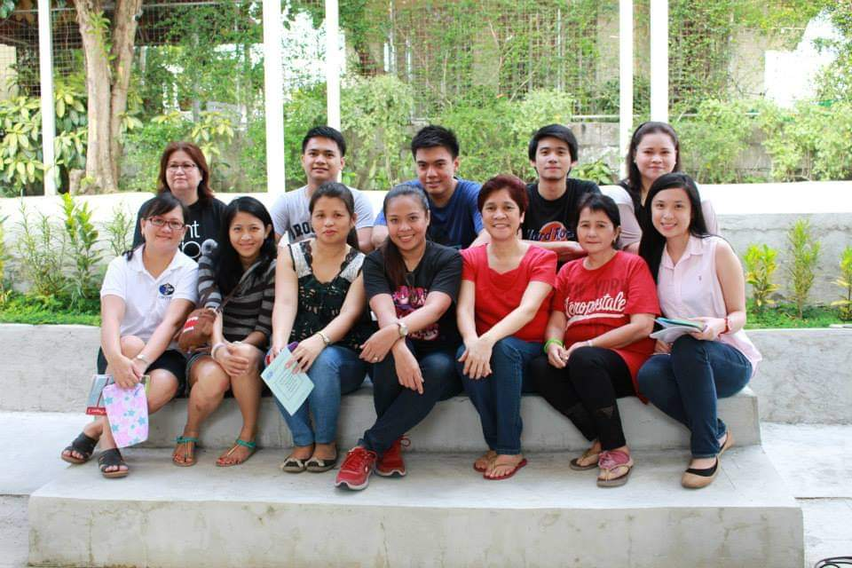
WORKERS TRAINING & RETREAT
TRECE MARTIREZ CAVITE, MARCH 28-29, 2014

Slide 6
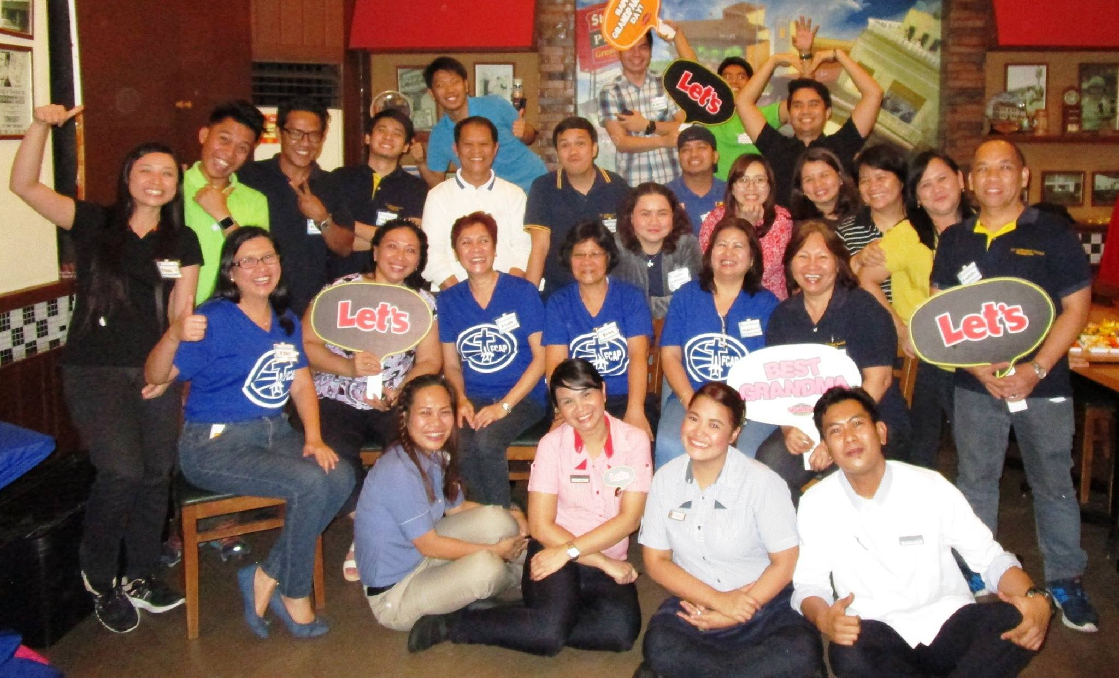
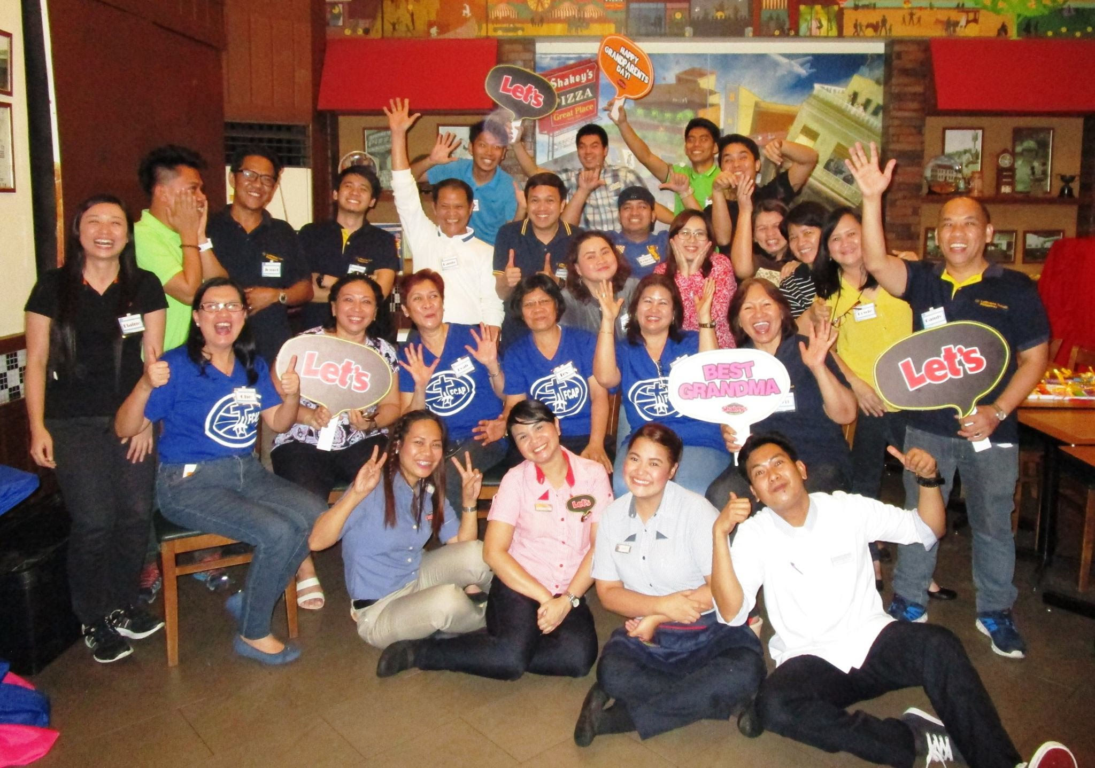
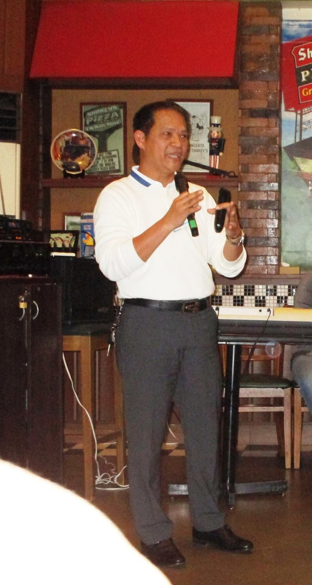
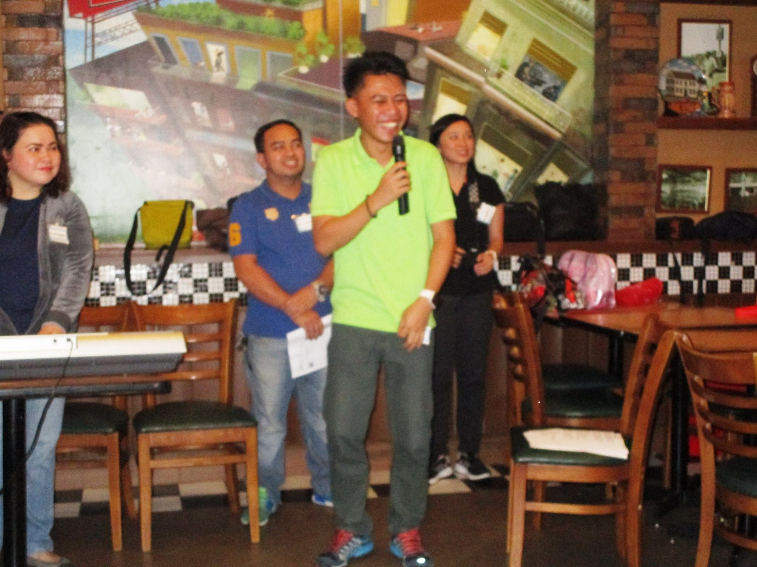
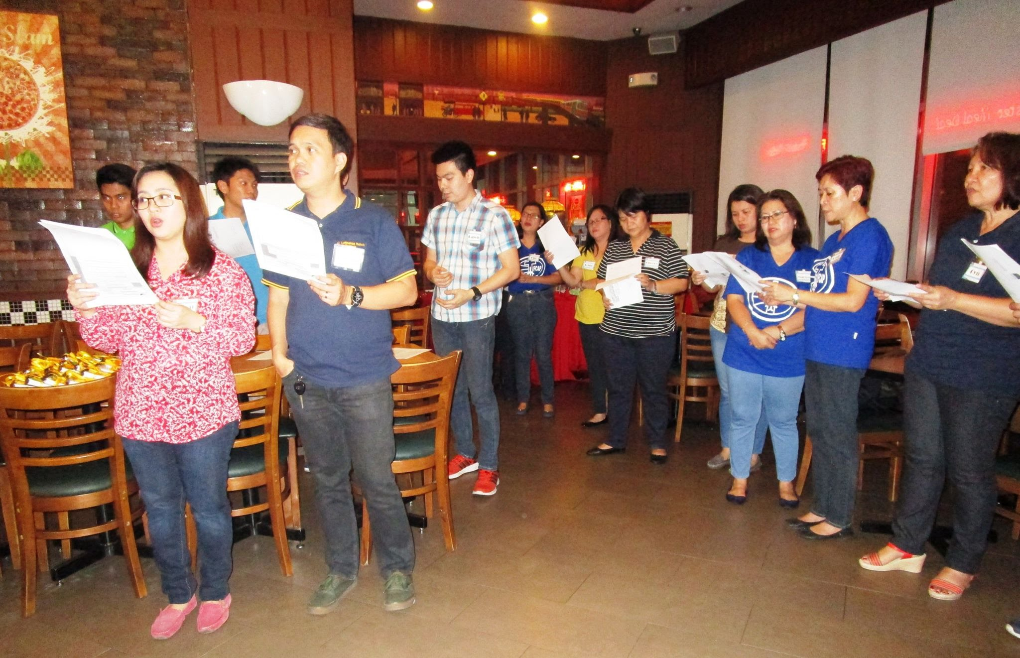
FCAP 16TH ANNIVERSARY

Slide 7
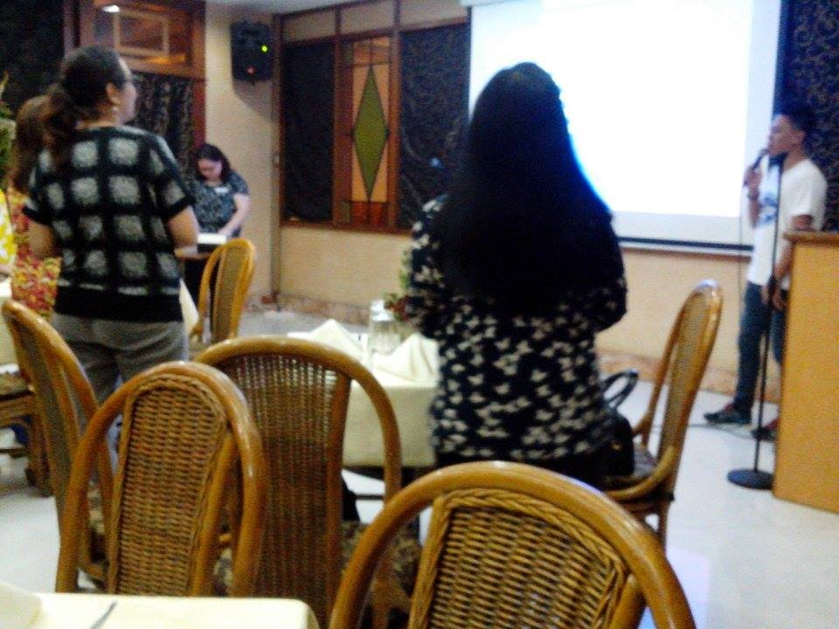
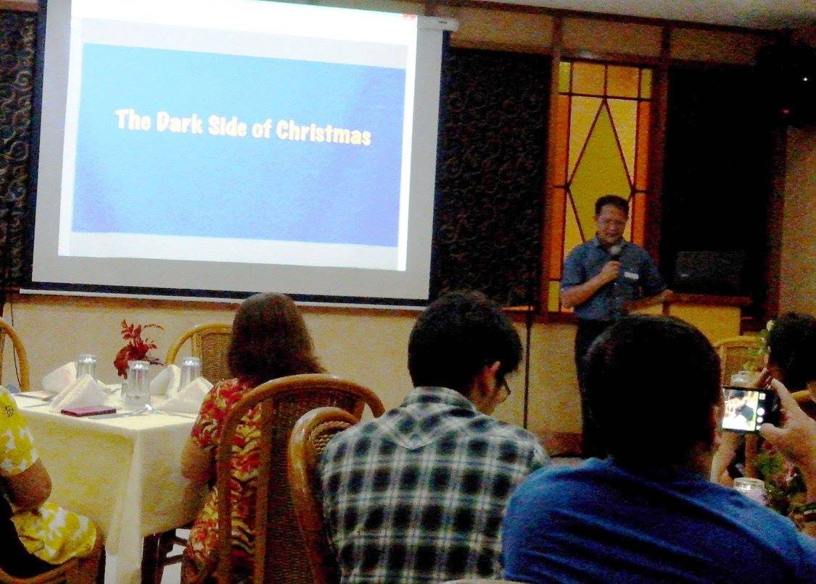
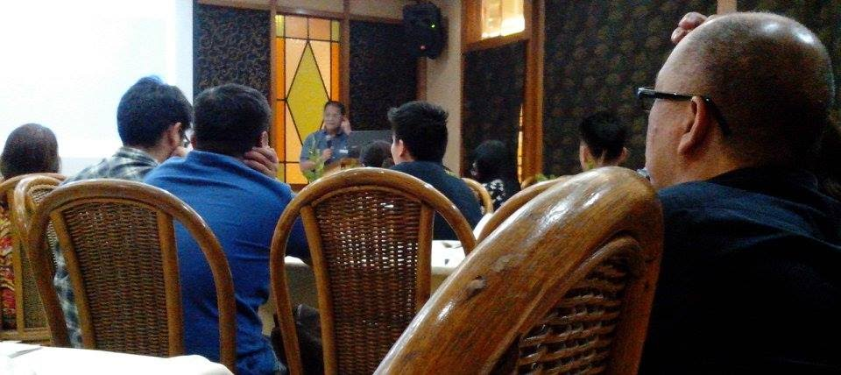
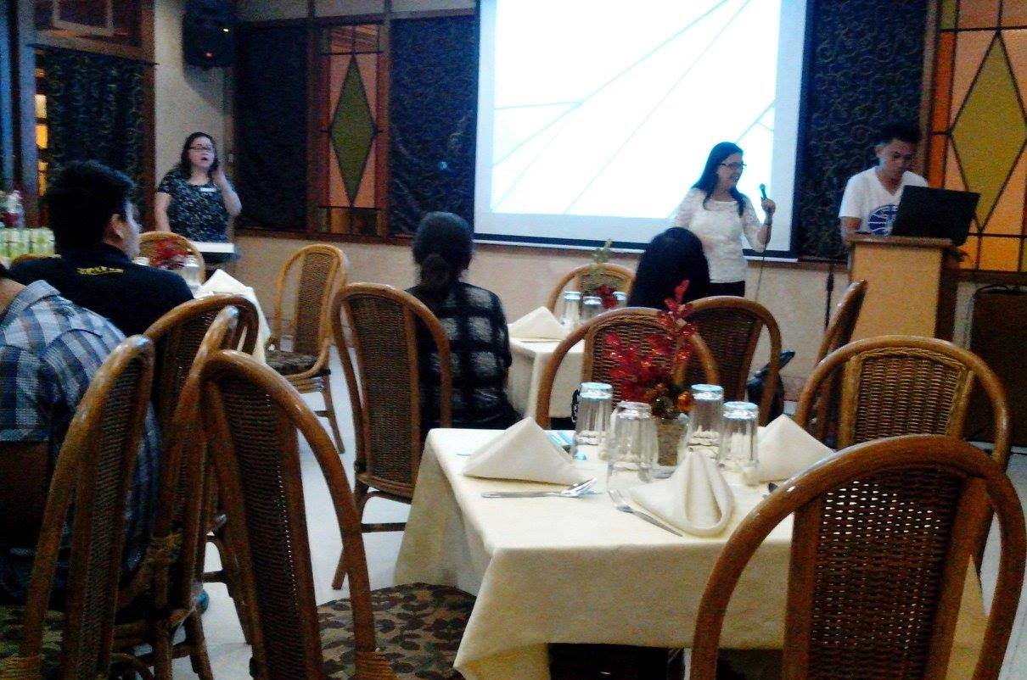
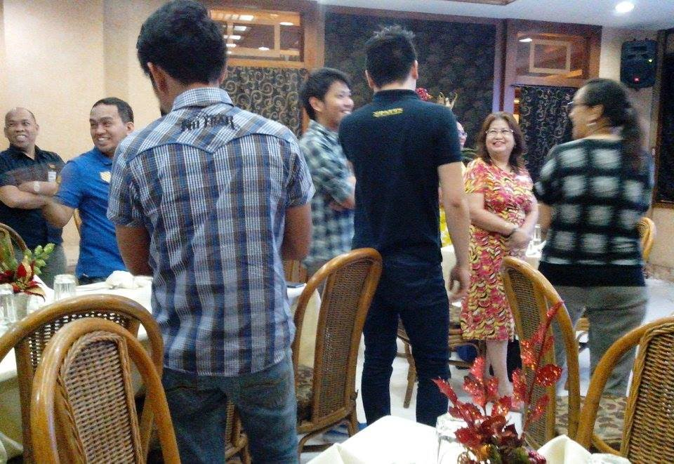
FCAP CHRISTMAS FELLOWSHIP
KABAYAN HOTEL, PASAY CITY - DEC 6, 2016

Slide 8
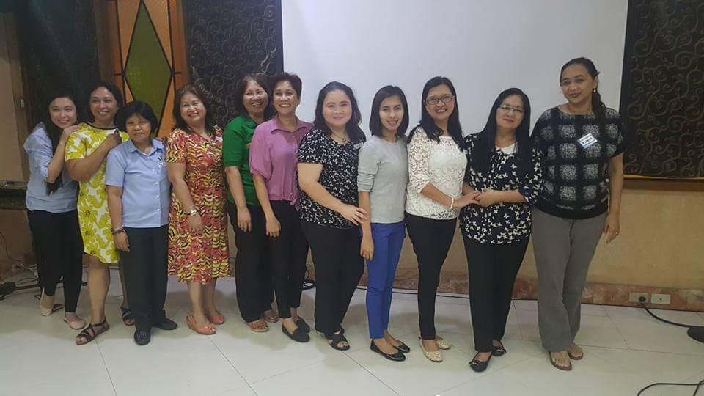
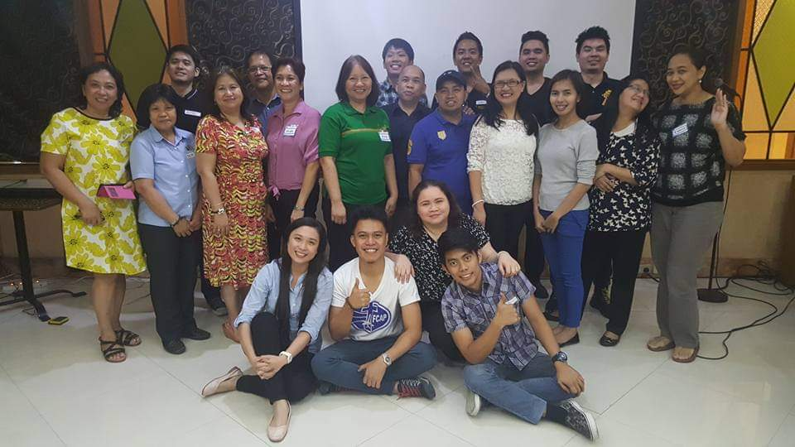
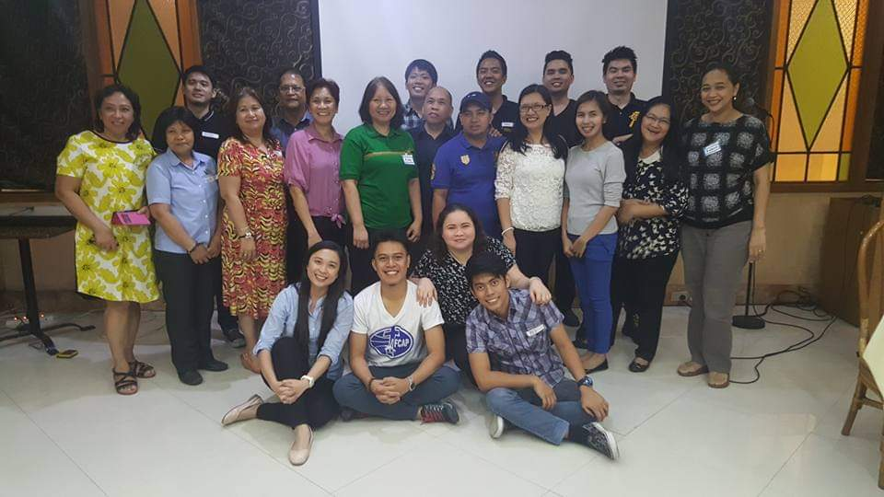
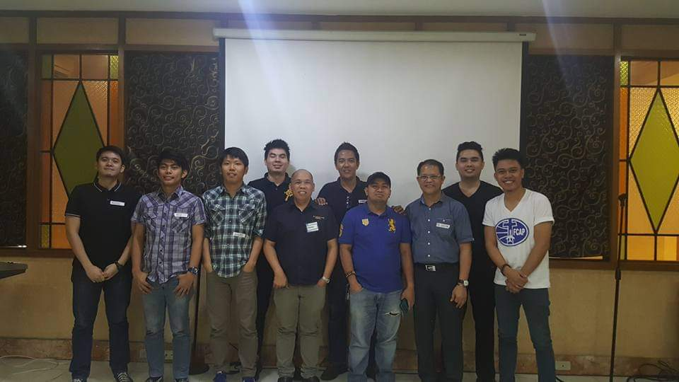
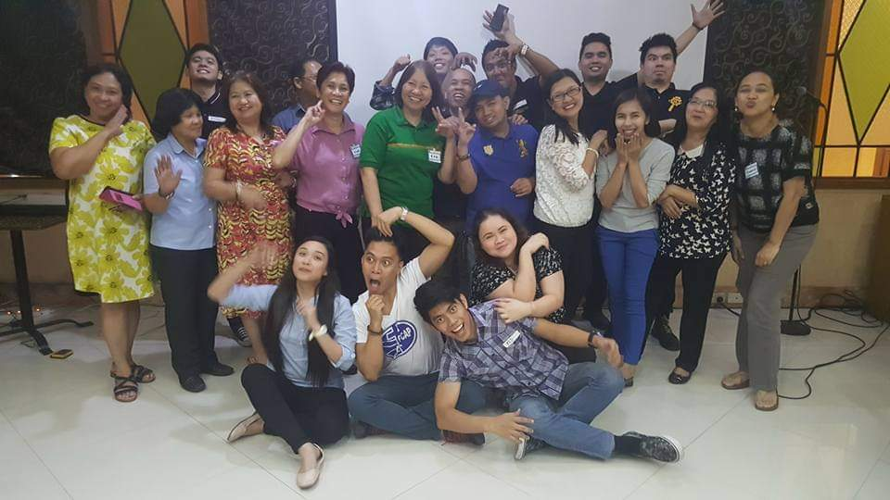
FCAP CHRISTMAS FELLOWSHIP
KABAYAN HOTEL, PASAY CITY - DEC 6, 2016

Slide 9
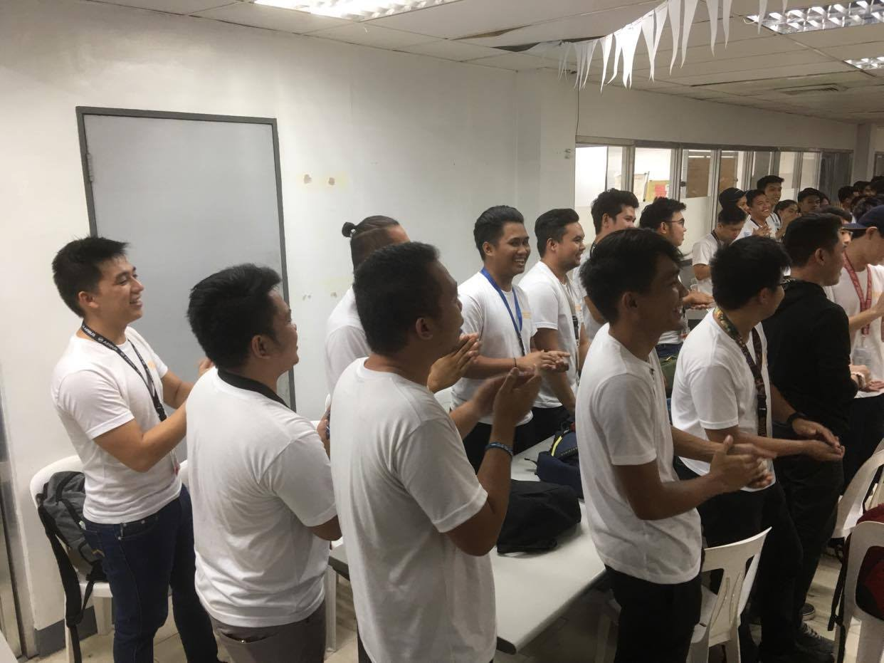
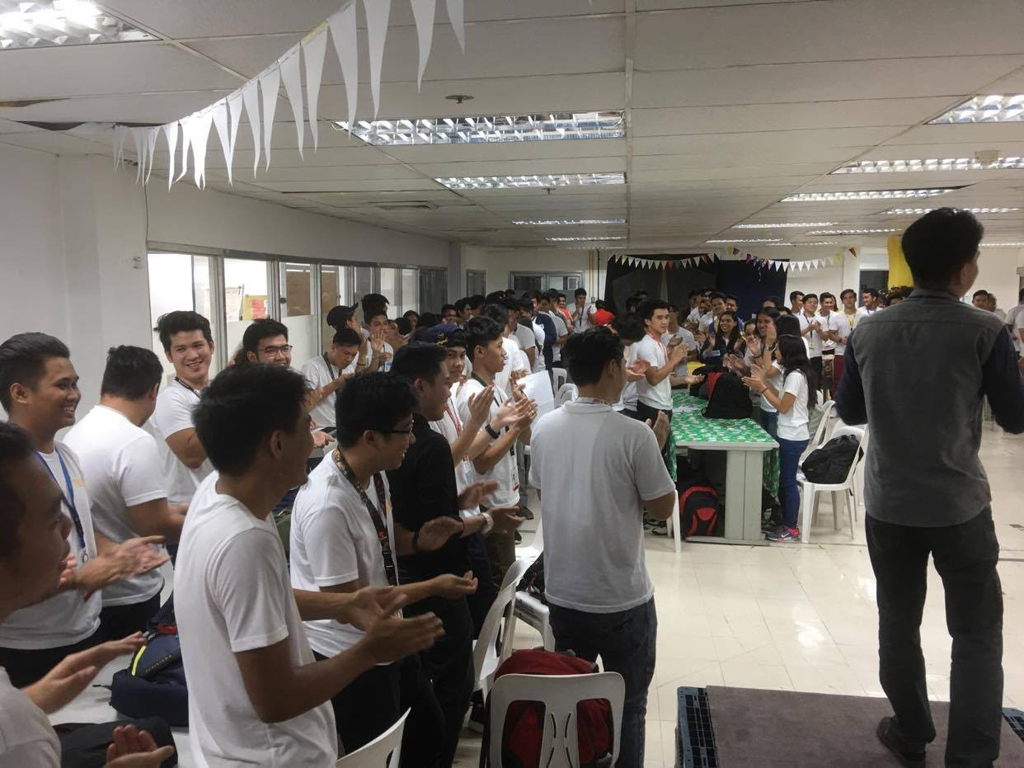
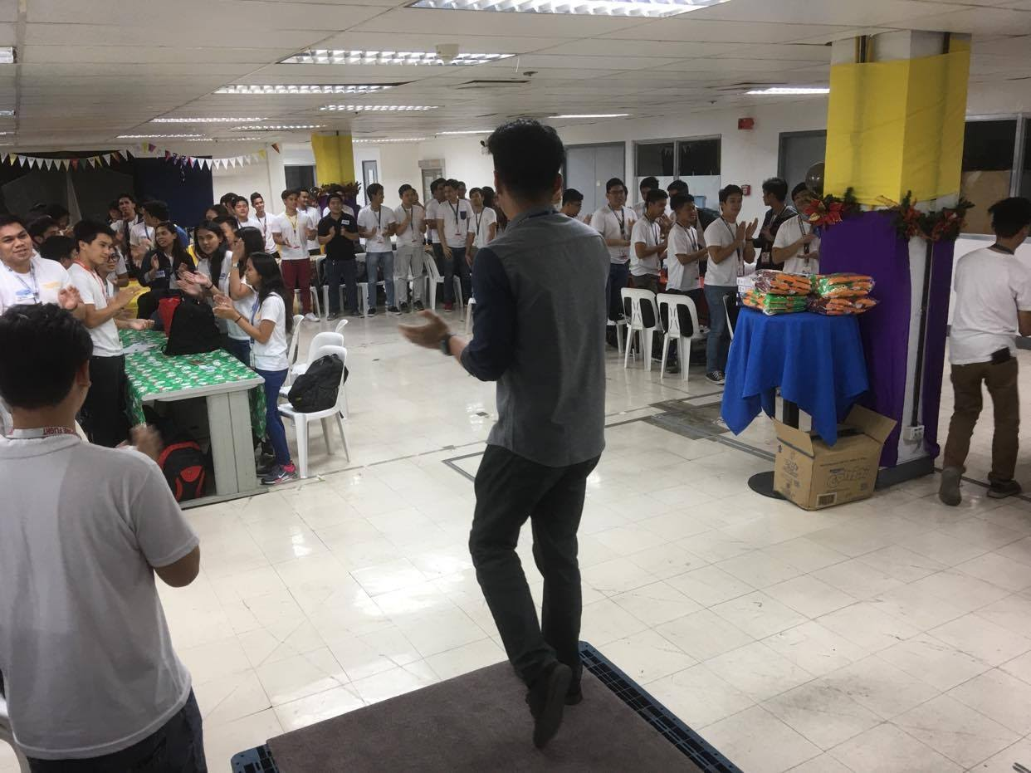
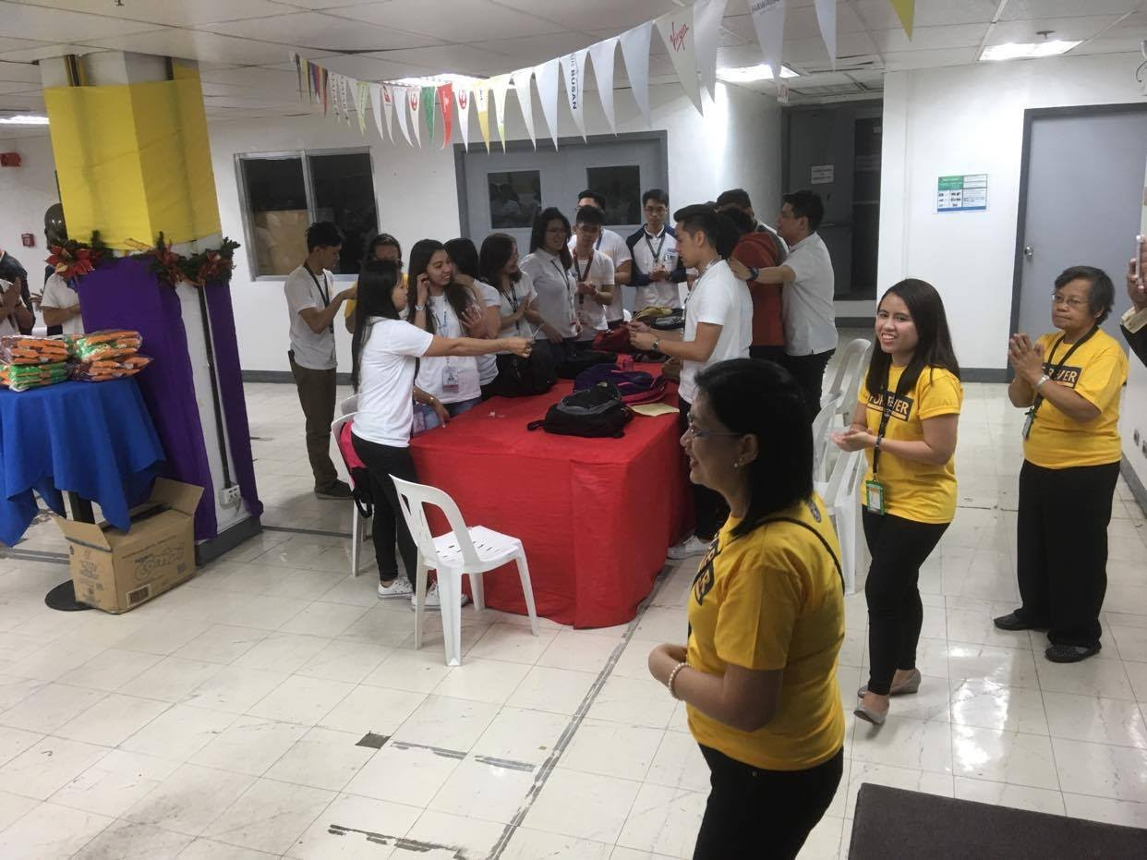
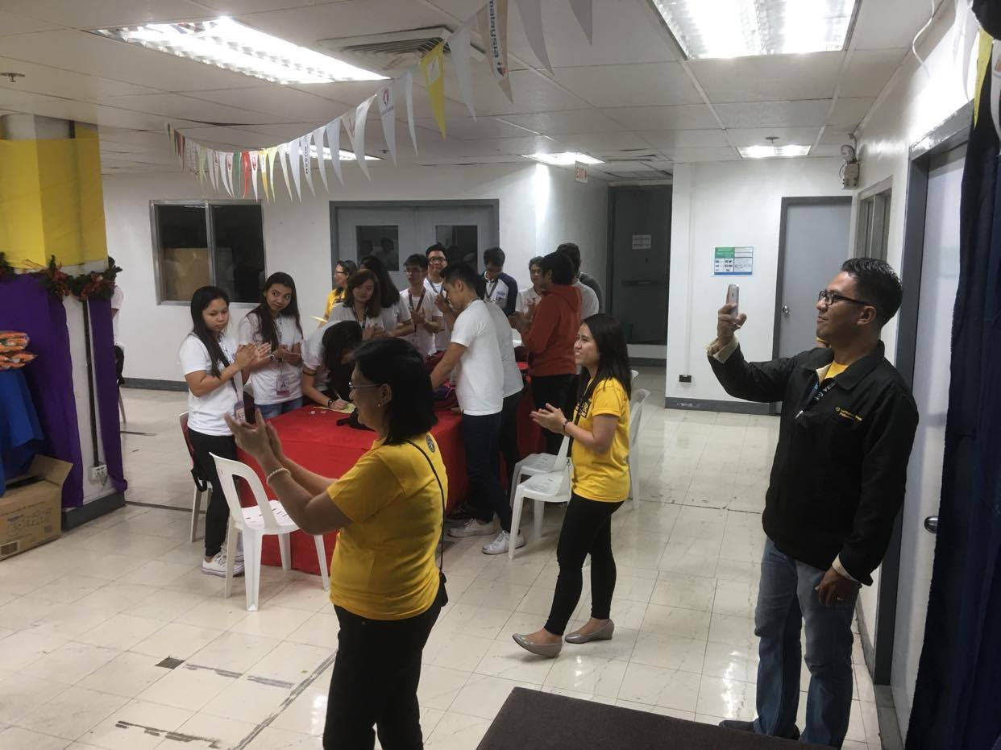
FCAP LTP-LTTP CHRISTMAS PARTY

Slide 10
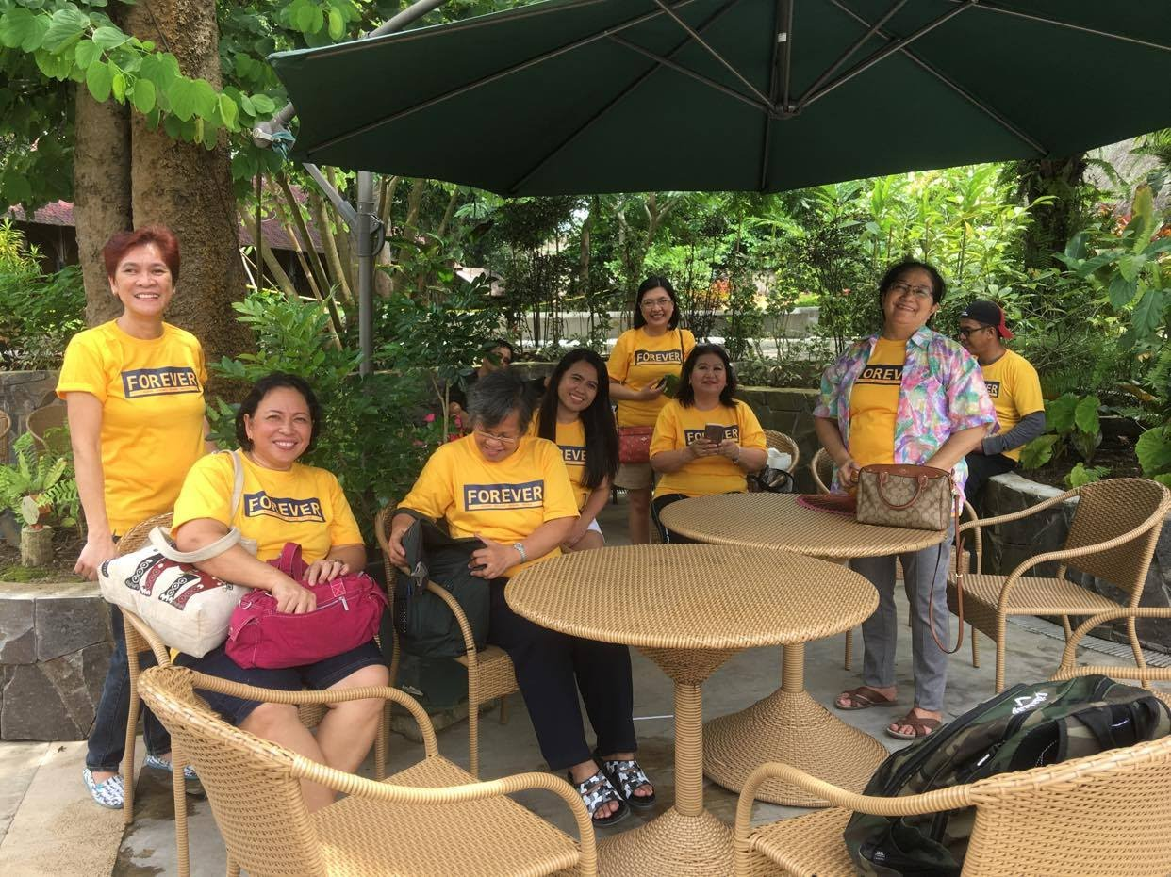
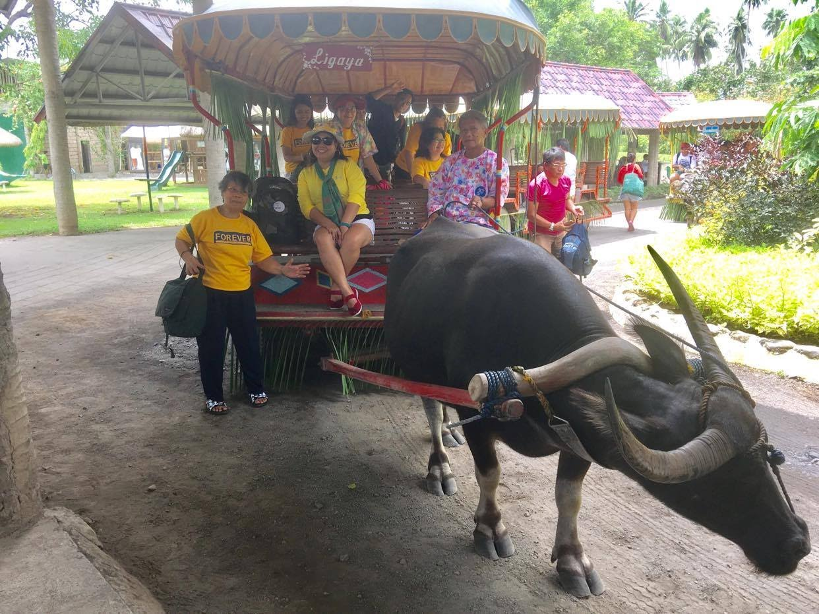
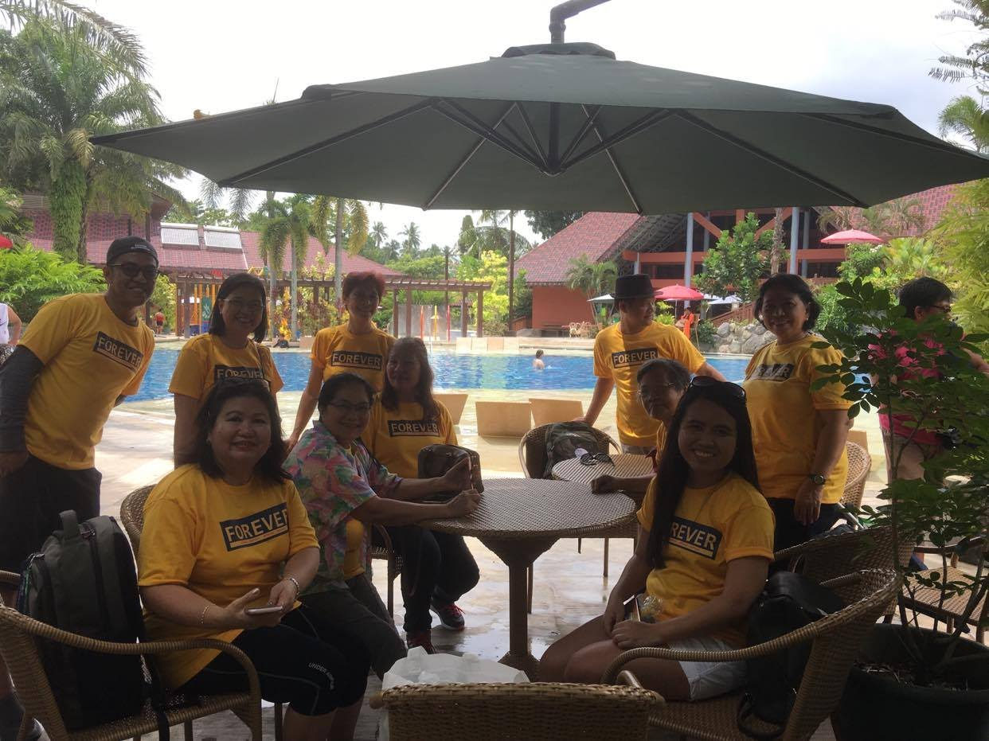
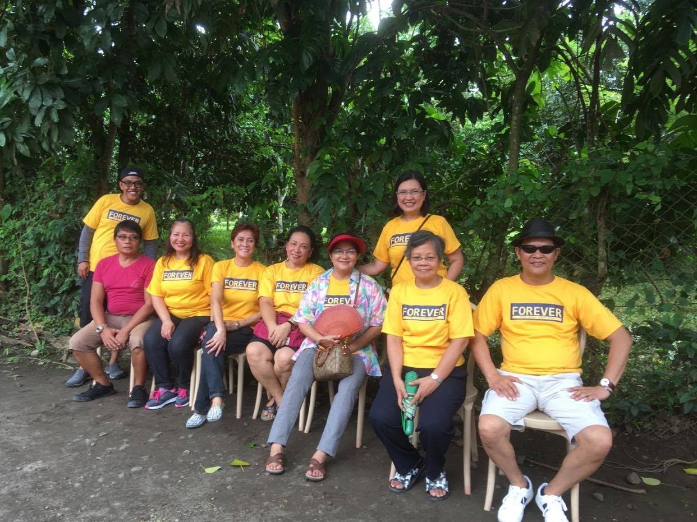
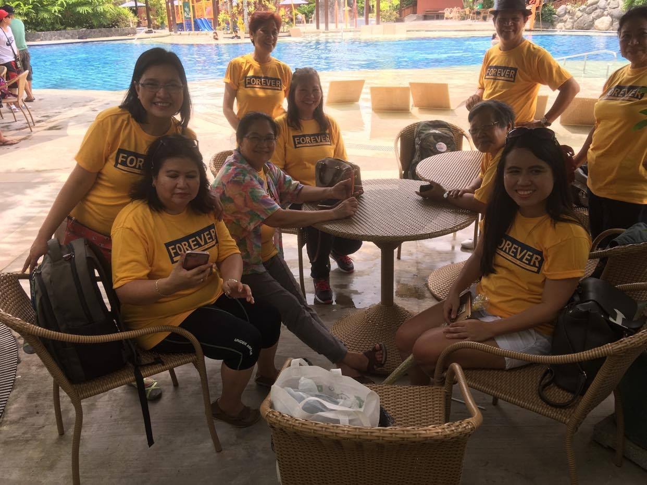
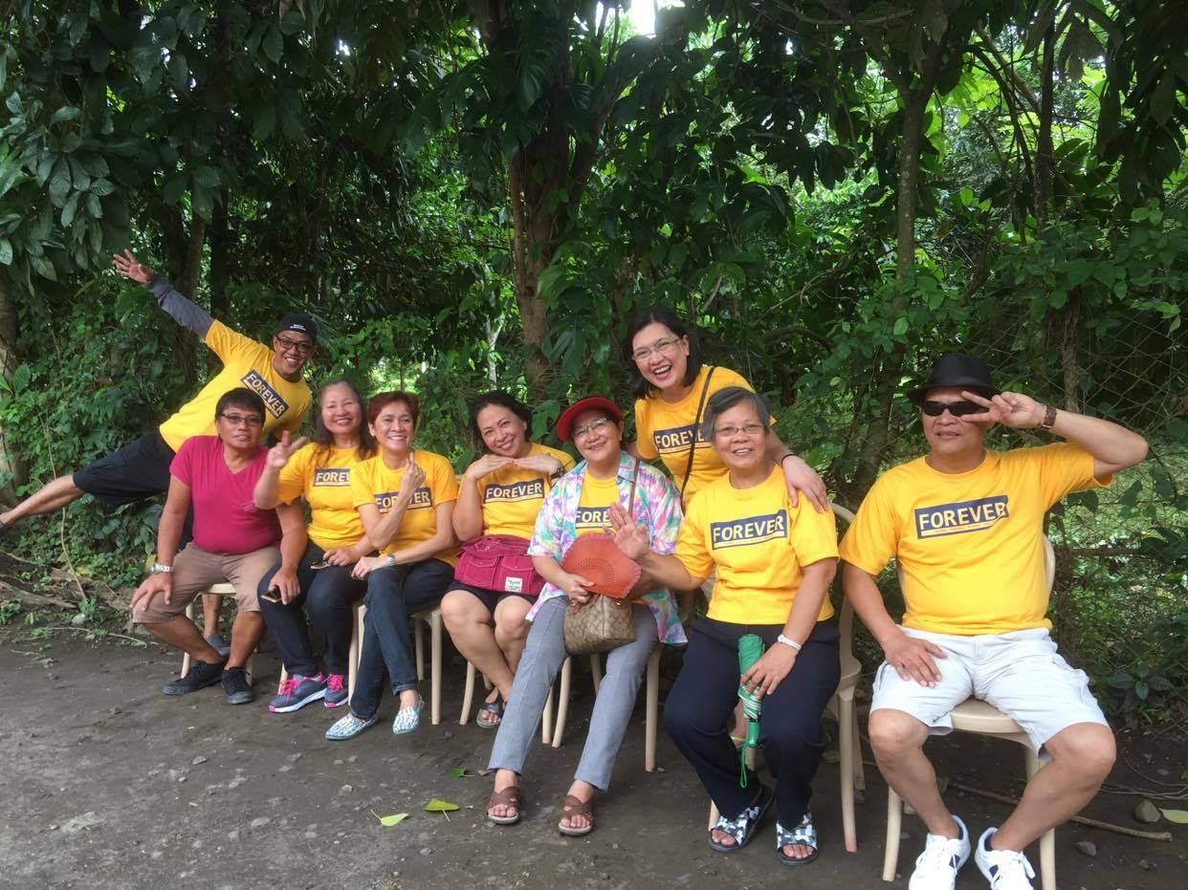
FCAP OUTING @ VILLA ESCUDERO 2017

Slide 11





RETREAT, MISSION & 18TH YEAR ANNIVERSARY WITH GLAD TIDINGS & KAKAWAN CHURCH CONGREGATIONS @ ROSARIO, BATANGAS SEPTEMBER 22-23, 2018

Slide 12




RETREAT, MISSION & 18TH YEAR ANNIVERSARY WITH GLAD TIDINGS & KAKAWAN CHURCH CONGREGATIONS @ ROSARIO, BATANGAS SEPTEMBER 22-23, 2018

Slide 13





RETREAT, MISSION & 18TH YEAR ANNIVERSARY WITH GLAD TIDINGS & KAKAWAN CHURCH CONGREGATIONS @ ROSARIO, BATANGAS SEPTEMBER 22-23, 2018

Slide 14




FCAP RETREAT 2019 @ PANSOL, LAGUNA

Slide 15






MISSION & 19TH ANNIVERSARY
@ CACABAY, TERNATE, CAVITE SEPT. 13-14, 2019

Slide 16





MISSION & 19TH ANNIVERSARY
@ CACABAY, TERNATE, CAVITE SEPT. 13-14, 2019

Slide 17



MISSION & 19TH ANNIVERSARY
@ CACABAY, TERNATE, CAVITE SEPT. 13-14, 2019
MISSION “KATIE’S WELL” at Brgy. Cacabay, Ternate, Cavite

Slide 18





RENDERED SONG TO LTP PRES. BURKHARD ANDRIC
& VP-QM THOMAS LAMBRECHT

Slide 19





FCAP FELLOWSHIP WITH GUEST SPEAKER FROM UNITED AIRLINES

Slide 20





FCAP FELLOWSHIP @ LTP BOARD ROOM

Slide 21








PRAYING FOR ONE ANOTHER

Slide 22



























Timothy SHIRLY
TESS
PTR. JAKE
TIMOTHY JAMES
RODEL
LOWIE
PTR. DANTE
SHINE
JOMEL
MARISSA
MOI
ANDRE
ANGEL
CYNTHIA
DJAY
ELAINE
EYAH
FAITH
FERNAN
HANNAH
JUN
KAT
LESTER
NANCY
QUENNIE
SHERLOU
WILVIE
RED
ROBERT
LTP-LTTP PHILIPPINES

Slide 23

THE LEADERS AT WORK
LTP-LTTP PHILIPPINES

Slide 24
“HOW BEAUTIFUL ARE
THE FEET OF THOSE WHO PREACH THE GOSPEL OF PEACE,
WHO BRING GLAD TIDINGS
OF GOOD THINGS!”
*** Romans 10:15 ***
LTP-LTTP PHILIPPINES

Slide 25
LTP-LTTP PHILIPPINES
To God Be the Glory. Thank You!

